Slide 1
Dominion Resources
Solar Power & Public Policy

Slide 2
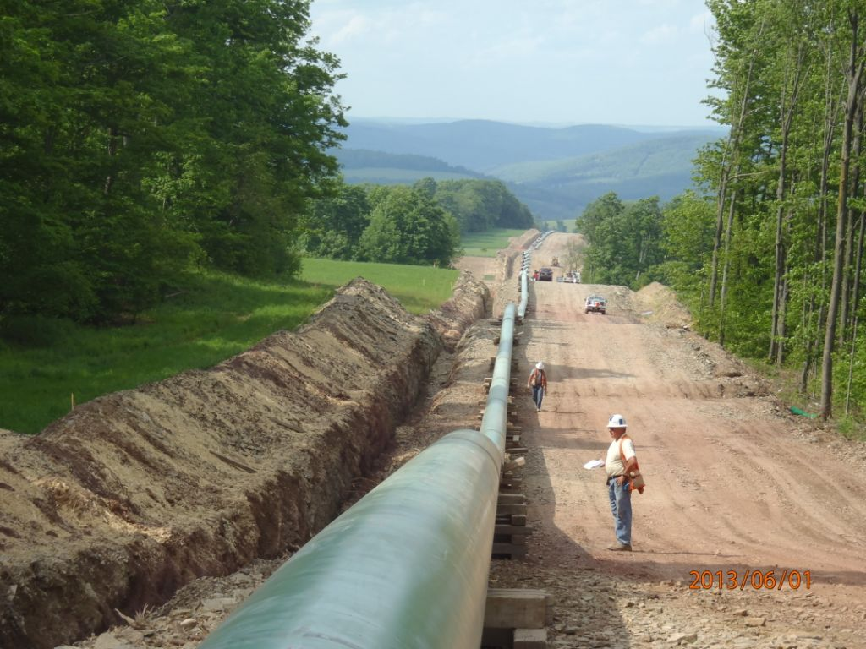
Dominion Profile
Primary Operating Segments View
Dominion Virginia Power
Dominion Energy
Dominion Generation
Electric Transmission
6,455 miles of transmission lines
Favorable regulatory environment
Electric Distribution
57,100 miles of distribution lines
2.5 million franchise retail customer accounts in VA and NC
Gas Transmission
Together with Gas Distribution, operates one of the largest natural gas storage system in the U.S.
12,200 miles of pipeline in eight states
Well positioned in Marcellus and Utica Shale regions
Gas Distribution
21,900 miles of distribution pipeline and 1.3 million franchise retail natural gas customer accounts in OH & WV
Dominion Retail
Retail Gas & Products/Services
1.2 million non-regulated customer accounts in 13 states
Utility Generation
20,400 MW of capacity
Balanced, diverse fuel mix
Favorable regulatory environment
Merchant Generation
4,000 MW of capacity, including nuclear, gas and renewable power
Active hedging program for energy revenue/margins

Slide 3
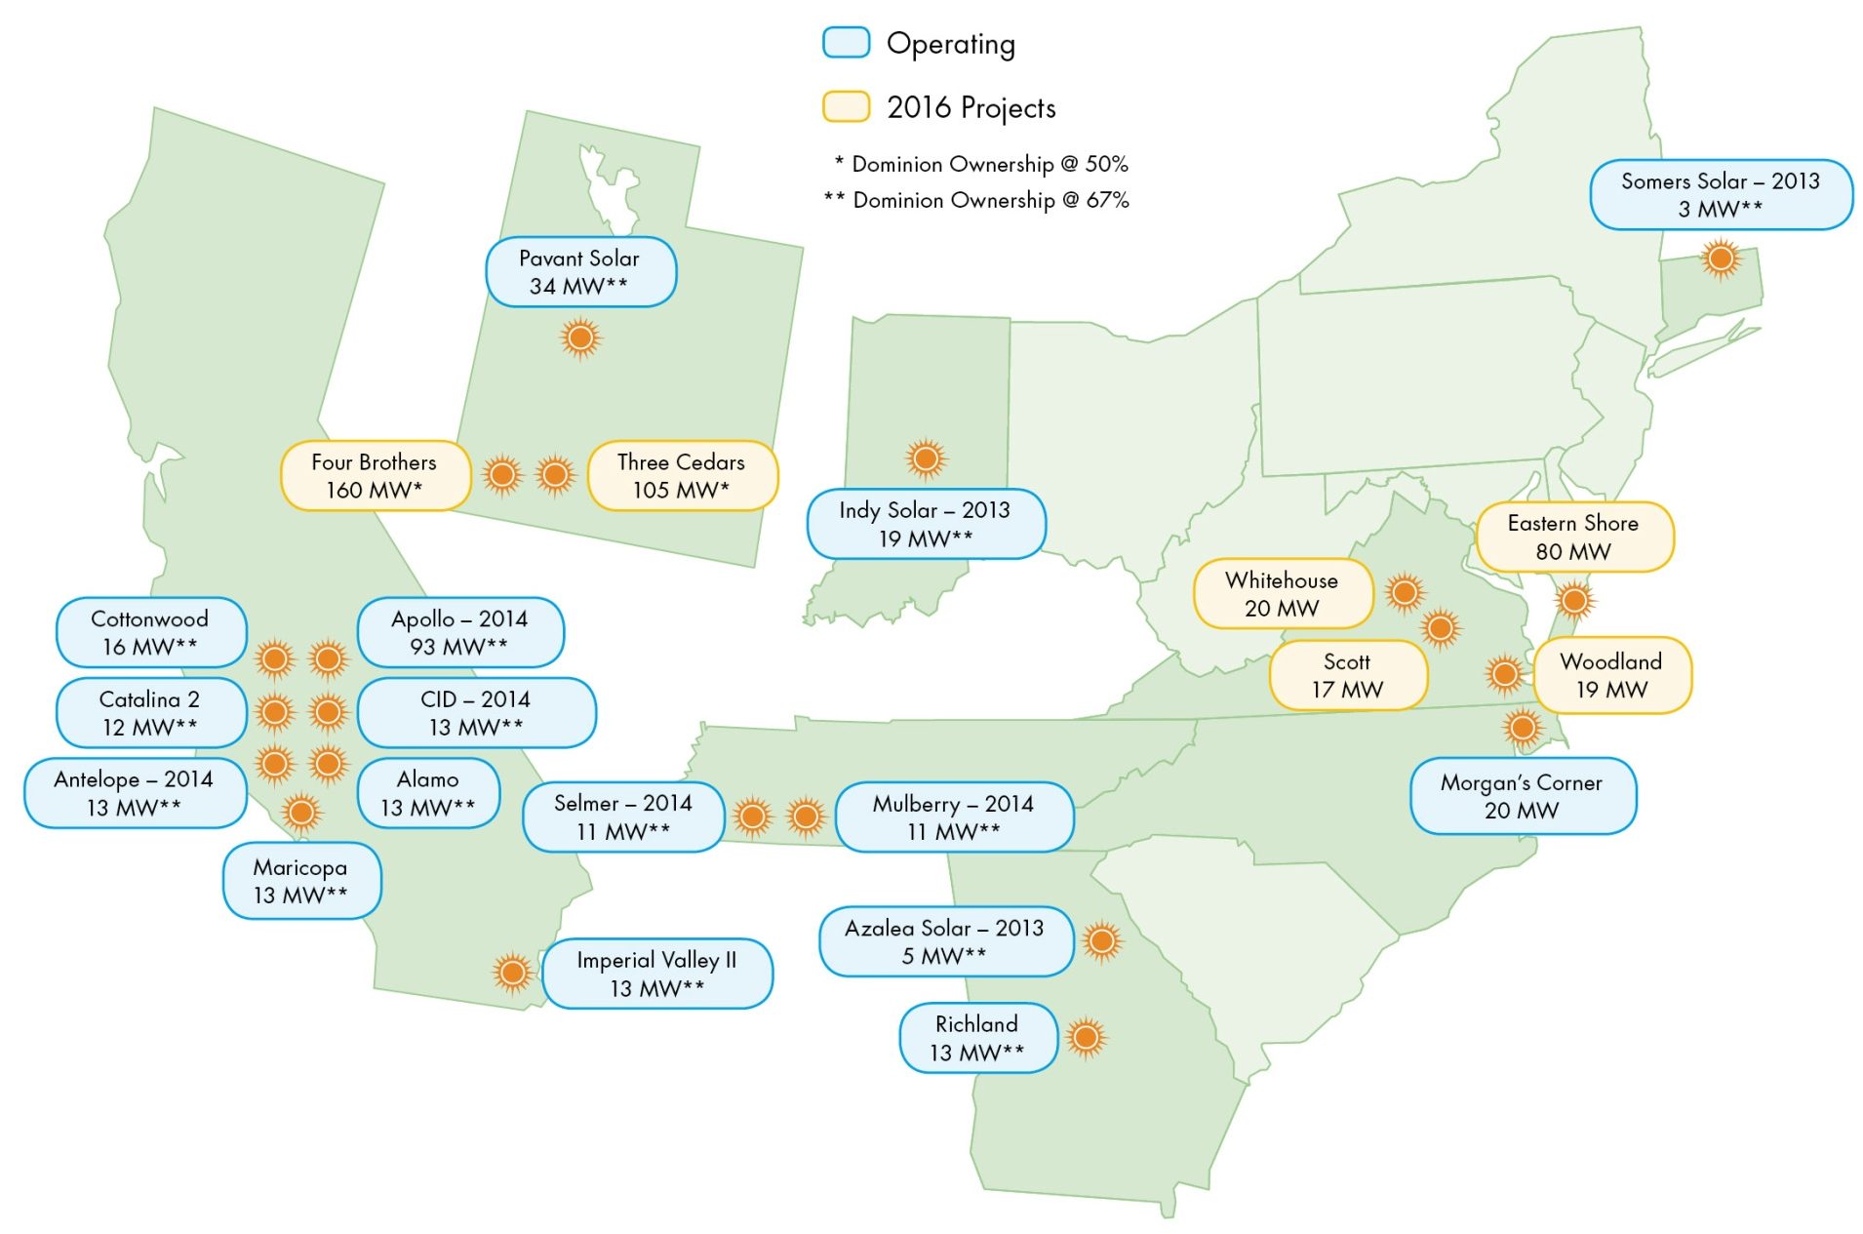
Dominion Profile
Dominion’s Current Utility Scale Solar Portfolio

Slide 4
Dominion Profile
Dominion’s Current Merchant Utility Scale Solar Facilities
Facility Name | Project Size (MW AC) | Dominion Ownership % | Year COD | Location | PPA Offtaker(s)
Somers | 5 MW | 67% | 2013 | Connecticut | Connecticut Light & Power Co.
Azalea | 8 MW | 67% | 2013 | Georgia | Cobb Electric Membership Corp.
Indy I, II, III | 29 MW | 67% | 2013 | Indiana | Indianapolis Power & Light
Kent South | 20 MW | 67% | 2014 | California | Pacific Gas & Electric
Adams East | 19 MW | 67% | 2014 | California | Southern California Edison
Old River 1 | 20 MW | 67% | 2014 | California | Pacific Gas & Electric
Kansas | 20 MW | 67% | 2014 | California | Marin Clean Energy/Pacific Gas & Electric
Camelot | 45 MW | 67% | 2014 | California | CA Dept of Water Resources
Columbia 2 | 15 MW | 67% | 2014 | California | Southern CA Public Power Authority
Mulberry Farm | 16 MW | 67% | 2014 | Tennessee | Tennessee Valley Authority
Selmer Farm | 16 MW | 67% | 2014 | Tennessee | Tennessee Valley Authority
West Antelope | 20 MW | 67% | 2014 | California | Pacific Gas & Electric
CID | 20 MW | 67% | 2014 | California | Pacific Gas & Electric
Cottonwood (3 sites)¹ | 24 MW | 67% | 2015 | California | Marin Clean Energy
Catalina 2 | 18 MW | 67% | 2015 | California | Southern California Edison
Pavant | 50 MW | 67% | 2015 | Utah | Rocky Mountain Power (PacifiCorp)
Alamo | 20 MW | 67% | 2015 | California | Pacific Gas & Electric
Imperial Valley Solar 2 | 20 MW | 67% | 2015 | California | Imperial Irrigation District
Richland | 20 MW | 67% | 2015 | Georgia | Georgia Power
Maricopa West | 20 MW | 67% | 2015 | California | San Diego Gas & Electric
Four Brothers² | 320 MW | 50% | 2016 | Utah | Rocky Mountain Power (PacifiCorp)
Granite Mtn² | 130 MW | 50% | 2016 | Utah | Rocky Mountain Power (PacifiCorp)
Iron Springs² | 80 MW | 50% | 2016 | Utah | Rocky Mountain Power (PacifiCorp)
Amazon Solar US East² | 80 MW | 100% | 2016 | Virginia | Vadata (Amazon)
TOTAL | 1,035 MW_{AC} | 630 MW_{AC}
¹Marin Carport facility (1 MW) to be placed in service in 2016
²Currently under construction

Slide 5
Dominion Profile
Planned Regulated Utility Scale Solar in Virginia
Up to 400 MW of Solar in VA will help meet near-term carbon reduction targets
Expected Cumulative MWs In-Service
Total Incremental Capex of ~$700 million

Slide 6
Announced VA Regulated Utility Scale Solar
Scott Timber Solar Facility
119 acre site located in Powhatan County
17 MW_{AC} Single Axis Tracking
Virginia Solar LLC development project
(selected from 2015 Solar RFP)
Whitehouse Solar Facility
250 acre site located in Louisa County
20 MW_{AC} Single Axis Tracking
Dominion internal development project
Woodland Solar Facility
200 acre site located in Isle of Wight County
19 MW_{AC} Single Axis Tracking
Coronal Development Services development project (previously HelioSage)
Remington Solar Facility
Partnership with the Commonwealth of VA (COV) and Microsoft
Long-term power purchase agreement with the COV
Renewable attributes (including solar RECs) sold to Microsoft
20 MW_{AC} facility in Fauquier County, VA
Commercial operations to begin 10/1/2017
Chesapeake Solar Facility
250 acre site in Chesapeake, Virginia
20 MW facility
Dominion purchasing the output of the facility, including energy, capacity and renewable energy credits, under a 20-year power purchase agreement.

Slide 7
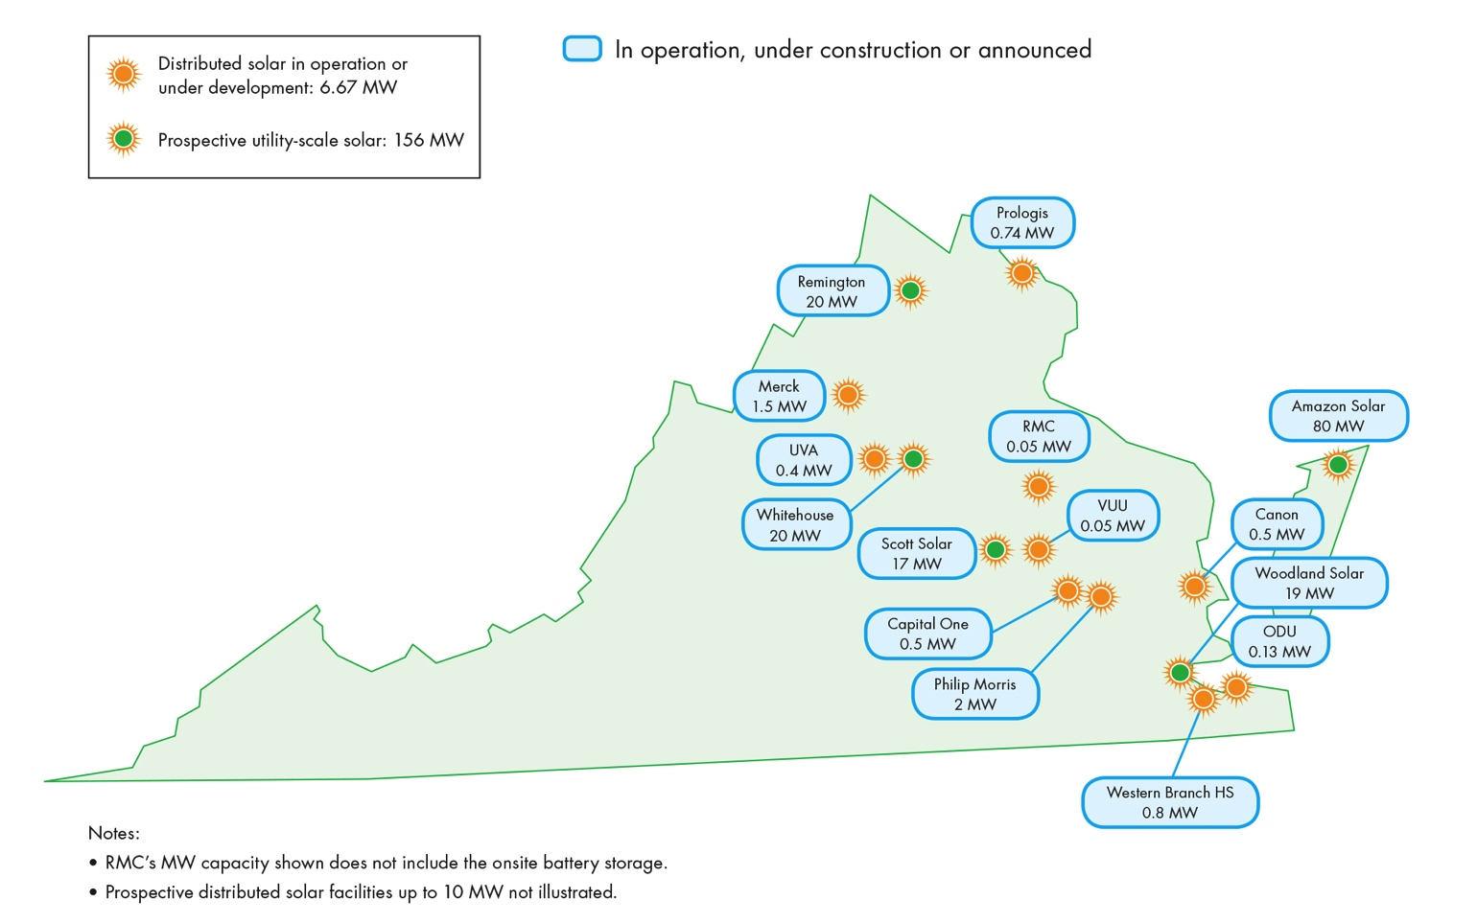
Dominion Profile
Dominion’s Currently Announced Solar Portfolio in Virginia (PJM)

Slide 8
Selected Solar Policy Issues
Lack of capacity value for intermittent resources in the PJM Capacity Market
Unless a resources is 365/24/7 there is a large risk to fully bidding into the PJM Capacity market.
PJM stakeholders recently approved a problem statement on this topic and created a Seasonal Capacity Senior Task Force – great first step.
Given where the country is headed with climate change policy, PJM needs a capacity construct that recognizes the value that intermittent generation provides to the capacity market.

Slide 9
Selected Solar Policy Issues
Removing Behind the Meter Solar Generation from the PJM Load Forecast
Beginning with their most recent load forecast, PJM has started subtracting projected behind the meter solar distributed generation from it’s load forecast.
We need to be careful to verify over time that the forecasted distributed generation is real and reliable.
It doesn’t face the same kind of performance penalties as non-distributed generation if it is not available during an emergency event.
We are concerned that we are not planning transmission to serve load in the future if these intermittent resources are not available.
As the amount of distributed generation grows, should we develop planning assessment criteria that will add these solar MWs back and run assessments to consider this operating condition?

Slide 10
Selected Solar Policy Issues
PURPA Reform
We believe that there is a need for FERC to revise the rebuttable presumption that the Commission adopted in the context of PURPA section 210(m) that qualifying facilities (QFs) 20 megawatts and below do not have nondiscriminatory access to competitive organized wholesale markets and the barriers to access encountered by these facilities.
It has been our experience that some of the developers in our NC service territory (which is still a part of PJM) are utilizing PURPA to obtain mandatory long term lucrative power purchase agreements with integrated, rate regulated utilities even though they have access to PJM’s markets.

